Slide 1
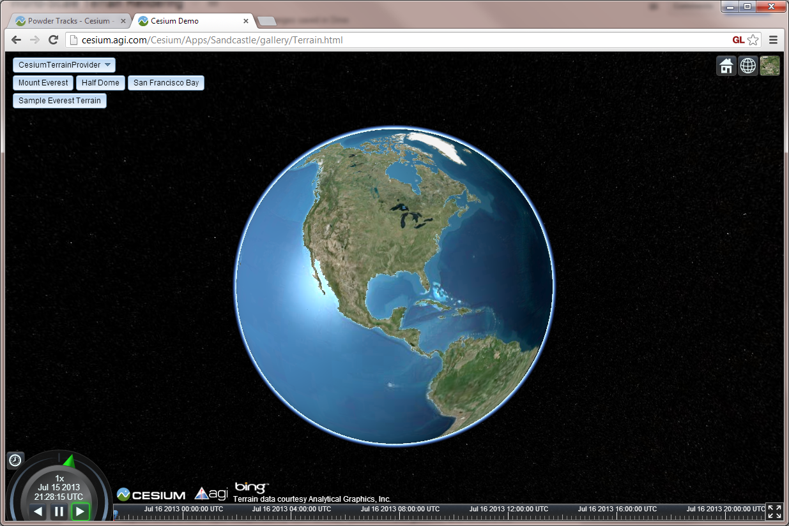
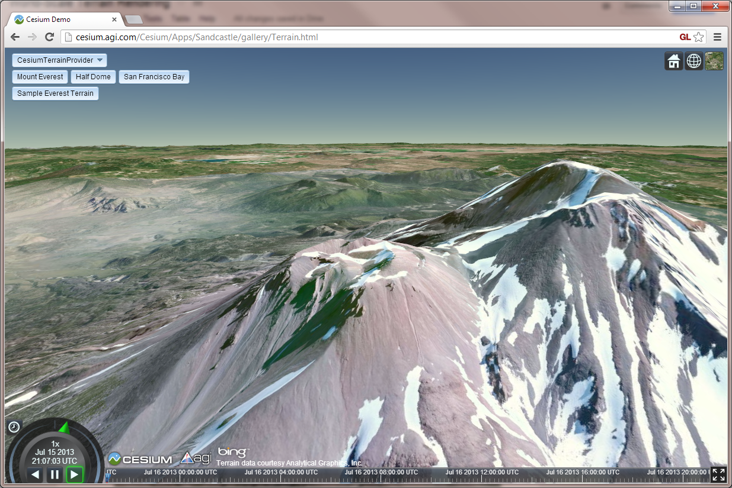

World-Scale Terrain Rendering
(Slides: cesium.agi.com/massiveworlds)
Kevin Ring
Analytical Graphics, Inc.
Notes:
Hi, I’m Kevin Ring. I work with Patrick Cozzi at Analytical Graphics on our virtual globe library, called Cesium. I’d like to talk to you today about how we implemented world-scale terrain rendering in Cesium.

Slide 2
Terrain in Cesium
Notes:
And when I say world, I literally mean planet Earth. We render an accurate model of the Earth, from a global view where the entire planet is visible….

Slide 3
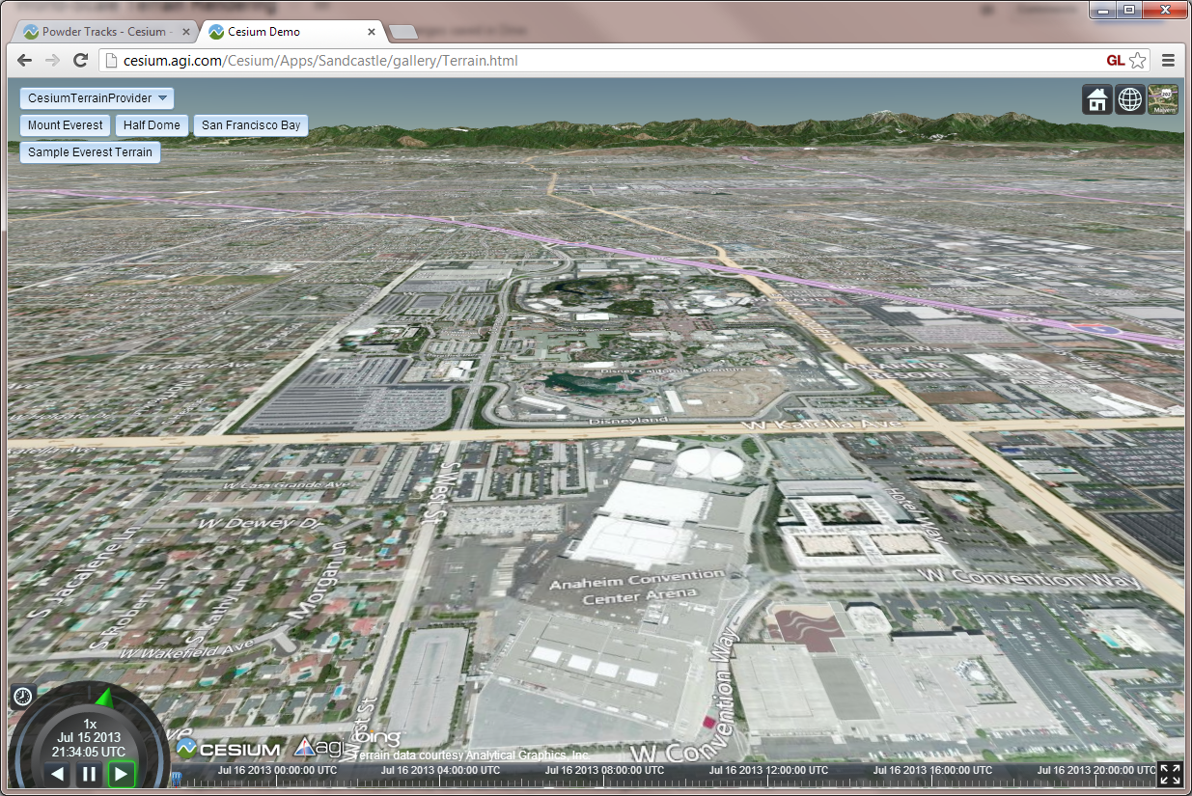
Terrain in Cesium
Notes:
… down to the street level where individual houses, cars, and trees are visible.

Slide 4
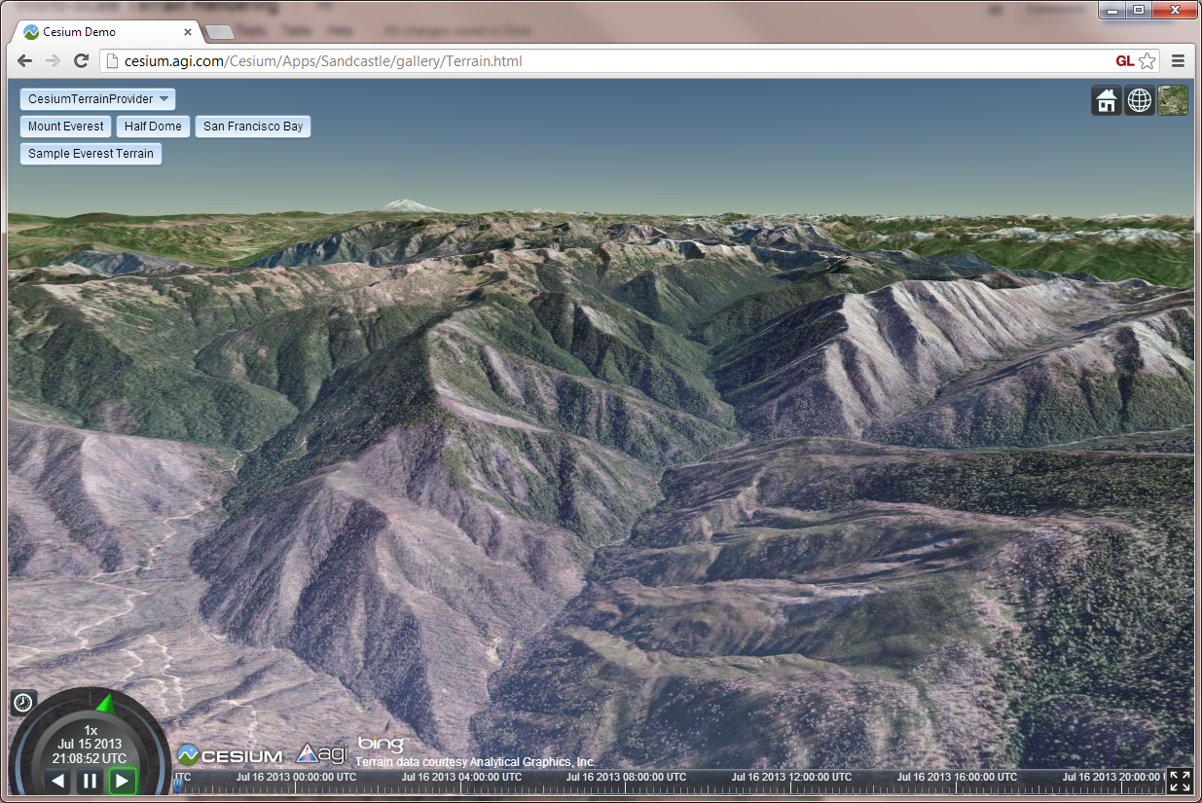
Terrain in Cesium
Notes:
And everywhere in between.

Slide 5
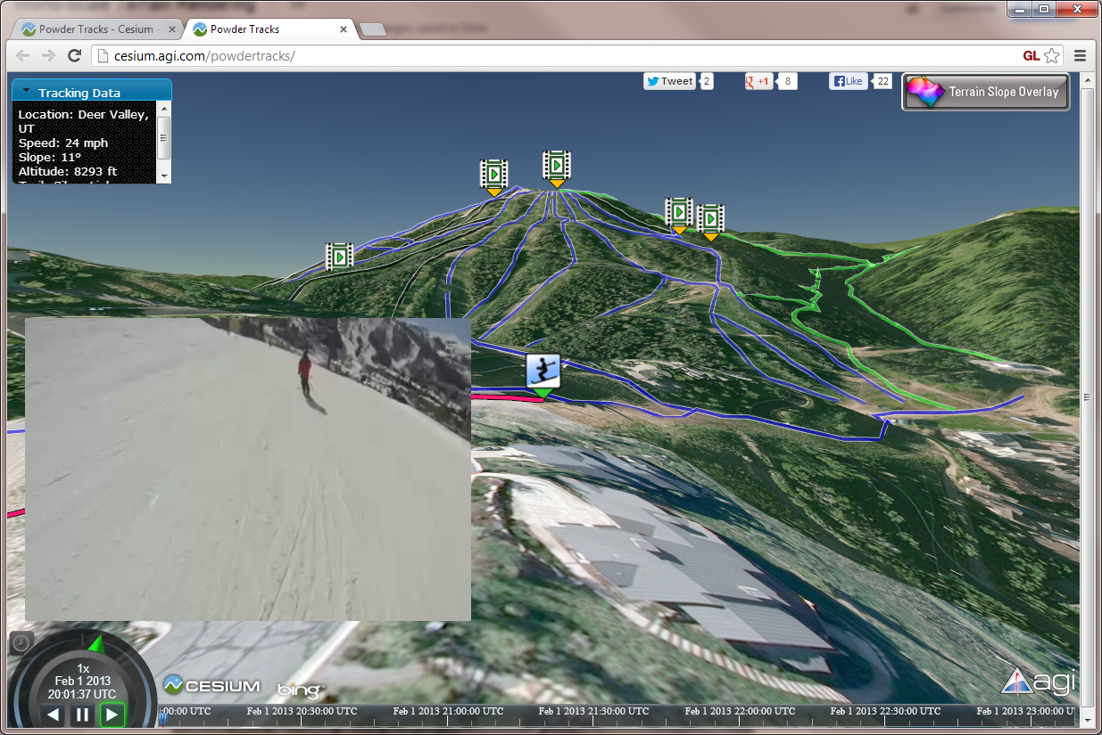
Terrain in Cesium
Notes:
And overlay the terrain with lines, markers, and other vector features.

Slide 6
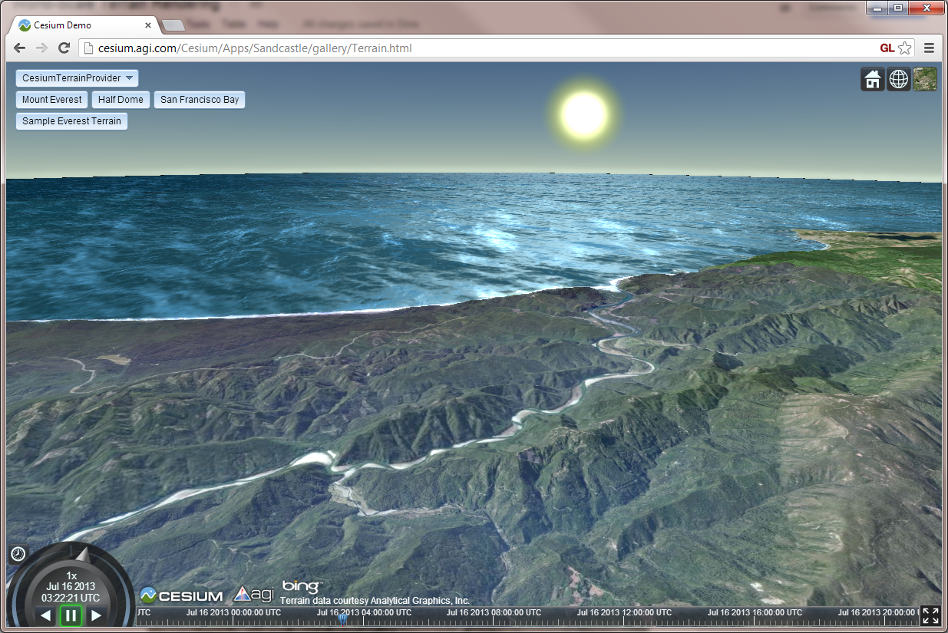
Terrain in Cesium
Notes:
Of course, this has all been done before. What’s perhaps more notable about Cesium is that it runs entirely in a web browser without a plugin, by leveraging WebGL, Web Workers, and other recent web technologies.

Slide 7
Terrain in Cesium
Notes:
So, I’d like to tell you a bit about how we developed a world-scale terrain rendering engine in this constrained environment, including some tips on how we were able to run it reasonably well in the even more constrained environment of a web browser running on Android mobile devices.

Slide 8
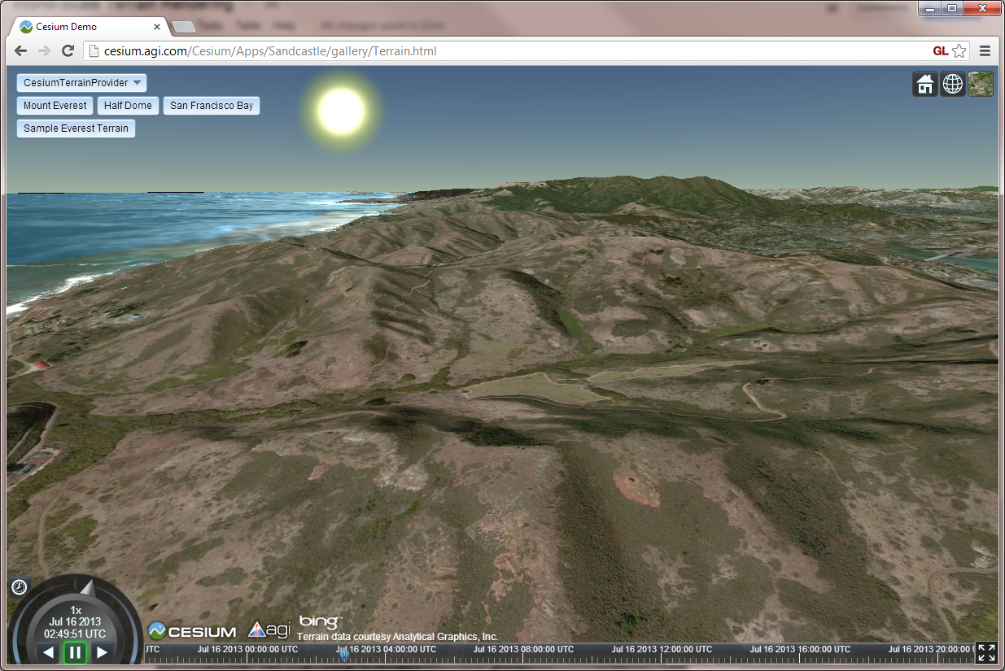
Terrain in Cesium
Notes:
Of course, I don’t have enough time to cover everything, so I encourage you to also go right to the source if you’re interested in more details. Everything I’ll be talking about here is open source under the permissive Apache 2.0 license, and .. well, I’ll call it “mostly” production quality.

Slide 9
Real-world data
Terrain and imagery collected by satellites and aerial instruments
Shuttle Radar Topography Mission (SRTM)
National Elevation Dataset (NED)
Landsat satellites
Digital Globe, SPOT, etc.
Terrain usually provided as a heightmap
Notes:
Cesium renders the real world, and that means we need real data.
Real terrain and imagery data for Earth and other planets is collected using satellites and other aerial instruments. For example, the Shuttle Radar Topography Mission (SRTM) obtained elevation data for most of the Earth’s surface with an instrument flying onboard the Space Shuttle Endeavor. Such data is typically made available as a giant heightmap, which, if you’re not familiar with the term, is just an image where each pixel is a terrain height.
The U.S. Government does a great job of making quality data, like SRTM, NED, and Landsat scenes freely available, if not easy to acquire. But…

Slide 10
Unfortunately…
The best data is hidden:
Within private networks
Within classified networks
Behind pay walls
By strict terms of use restrictions
Data is huge – up to hundreds of terabytes
We can’t access it ahead of time to transform it to a different form.
Notes:
… unfortunately, some of the best data is hidden within private and classified networks, or is only available for a fee. That means we can’t access it ahead of time to transform it to a different form for efficient rendering. To the extent possible, Cesium must work with existing sources of data, as they lie.

Slide 11





Terrain and imagery sources
Web Map Service (WMS)
Web Map Tile Service (WMTS)
Tile Map Service (TMS)
ArcGIS Map and Image servers
OpenStreetMap
Bing Maps
Google Maps
Notes:
And “as they lie” in the case of a web-based application like ours means remote servers that talk a variety protocols, like the ones listed here. Now the point here isn’t “hey look at all the great stuff we support.” Actually, if you look closely at this list, you may see one or two that we don’t actually support yet. The point is, we have to work with what we have. In many applications – games, especially – an asset pipeline is used to produce assets in a form that is ideal for the rendering engine. In Cesium, we may not even know what our assets are until runtime.
A typical Cesium application will include a terrain layer plus one or more imagery layers. And there is a lot of variability among these layers…

Slide 12
Layers are different
Different:
Map projections
Extents
Tiling schemes
May need on-the-fly adjustments:
Hue
Saturation
Gamma
Notes:
Different layers have different map projections, extents, and tiling schemes. Our rendering engine needs to cope with these differences on-the-fly. We also apply shader-based adjustments to the imagery on-the-fly. For example, when using Bing Maps imagery, we like to apply a gamma correction to brighten it up without washing out bright details.

Slide 13
Agenda
Overview of LOD algorithm – Chunked LOD
Mapping imagery to terrain
Map reprojection on the GPU
Horizon culling
Notes:
So those are the unusual challenges faced by Cesium - unusual compared to something like a game, anyway. With that introduction out of the way, here’s what I’m going to cover.
First I’ll talk about the level-of-detail algorithm we use for terrain rendering. We use an algorithm called Chunked LOD.
Then I’ll discuss what is – perhaps surprisingly – one of the more interesting aspects of Cesium’s terrain and imagery rendering engine. The process of mapping imagery from multiple sources, each with different projections, extents, and tiling schemes, to the terrain surface.
Related to that, I’ll discuss how we use the GPU to efficiently reproject imagery on-the-fly.
Finally, I’ll discuss how we do horizon culling. Horizon culling allows us to avoid rendering tiles that are below the horizon from a given camera viewpoint, and is an important optimization for rendering globe-conforming terrain. We have a fairly novel approach to this.

Slide 14
Agenda
Overview of LOD algorithm – Chunked LOD
Mapping imagery to terrain
Map reprojection on the GPU
Horizon culling

Slide 15
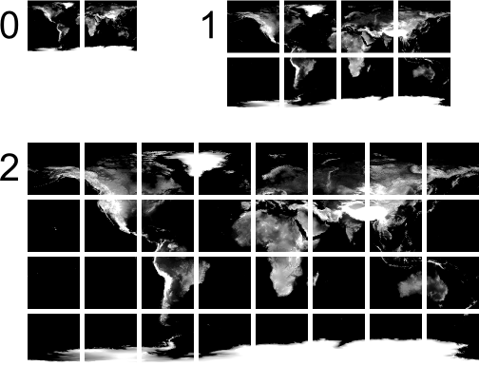
Chunked LOD
[Ulrich02]
http://tulrich.com/geekstuff/chunklod.html
Notes:
High resolution, worldwide terrain is, of course, much too large to render all at once. Instead, we render a subset of it. To select the subset to render each frame, we use the Chunked LOD algorithm. This algorithm was presented by Thatcher Ulrich at SIGGRAPH back in 2002.
The algorithm assumes that the terrain data is organized into a quadtree of tiles as shown here. Every level has a representation of the entire world, but using a different number of tiles. At level zero, there are just two tiles. At level one, each of those tiles has four children, for a total of eight tiles. A typical quadtree, right?

Slide 16
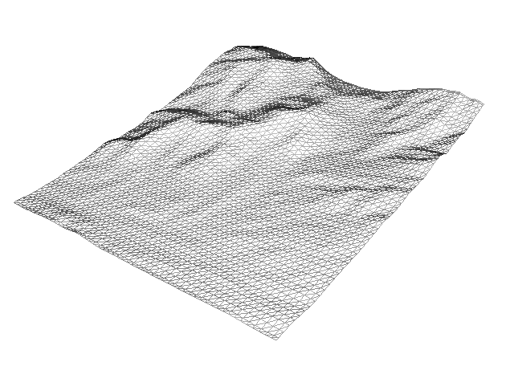
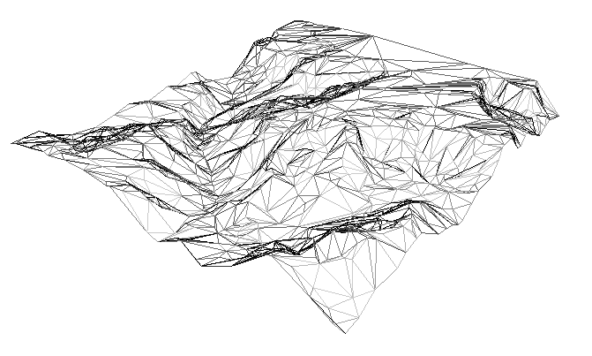
Tiles
Notes:
Each tile in our quadtree is a mesh covering a rectangular area in some map projection. If the terrain source is a heightmap pyramid, the mesh is a simple tessellation of the heightmap, as shown on the left. It can also be more irregular as shown on the right. Vertices of the mesh also contain texture coordinates, which are (0,0) in the southwest corner of the tile and (1,1) in the northeast corner. The coordinates change in proportion to the change in longitude and latitude over the tile, so they reflect a simple geographic projection.
The small, high-resolution tiles shown here look fairly planar, but don’t forget – we’re extruding terrain from WGS84, an ellipsoidal model of the Earth. With large tiles, the curvature becomes more apparent.

Slide 17
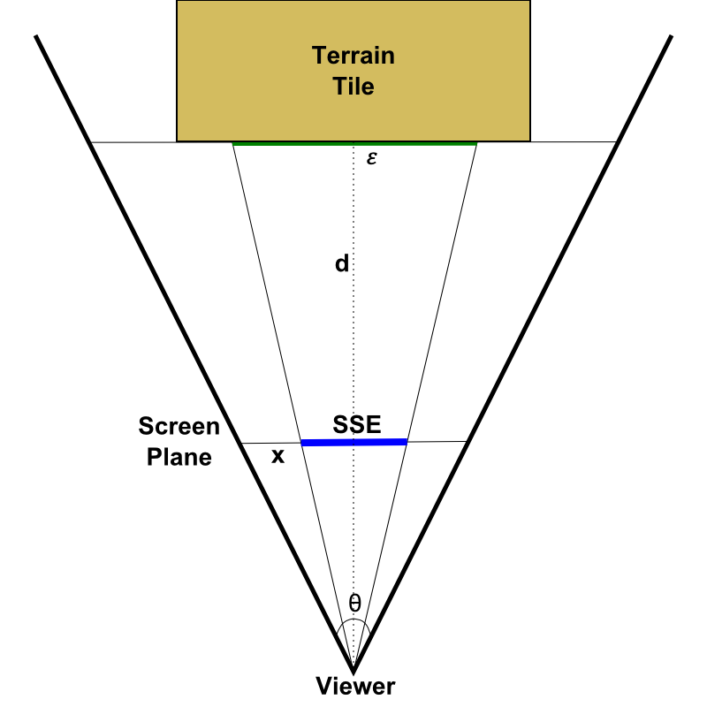
Screen-space error (SSE)
ε = geometric error of tile or level, in meters
x = width of the screen, in pixels
d = distance to tile, in meters
θ = camera field of view, in radians
Notes:
Intuitively, we want to render tiles near the root of the quadtree for parts of the terrain surface that are far away, and render tiles deeper in the quadtree for parts of the terrain that are near the viewer.
More formally, we drive tile selection by estimating screen-space error. Starting with the two tiles at level zero, we use the standard LOD equation shown here to estimate the error, in pixels on the screen, that will result if we render the tile rather than a more detailed representation of the area covered by that tile. If it’s too much error, usually one or two pixels, we refine, which means we consider that tile’s four children instead. This process proceeds recursively until we’ve selected tiles covering the entire visible portion of the globe.
The width of the screen and the field-of-view angle are easy and usually constant from frame-to-frame. The geometric error and distance quantities need a little explanation.

Slide 18
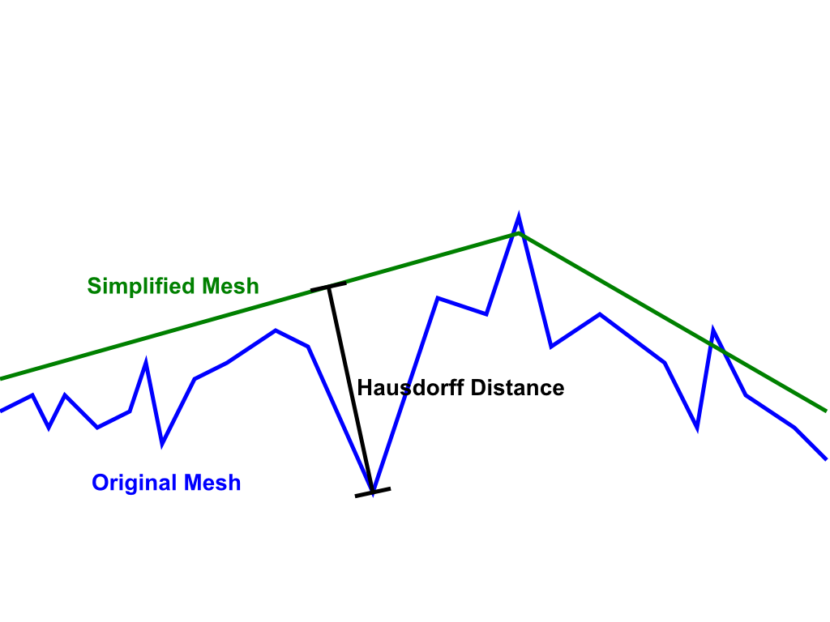
Geometric Error, ε
Geometric error is constant per level in the quadtree
[Klein96]
Notes:
Ideally, epsilon is the Hausdorff distance of the tile relative to the original, full-detail terrain in the region covered by the tile. Imagine we look at all of the points on the surface of the simplified mesh. For each of those points, we measure the distance from that point to the closest point on the original mesh. Then we do the same in reverse. For each point on the original mesh, we find the distance to the closest point on the simplified mesh. The greatest of those distances is the Hausdorff distance, and is an accurate measure of error in the simplified representation.
In practice, we may not be able to compute the Hausdorff distance precisely. In fact, in the case of heightmap-based terrain derived using a simple interpolation algorithm, we may not have an accurate error metric at all. In those cases, we simply choose a constant error value for each level in the quadtree so that we attain reasonable-looking terrain without rendering too many tiles. But we can’t make any guarantees about what screen-space error we actually achieve.

Slide 19
Distance to tile, d
Accurate approach: distance to closest triangle
Simple approach: distance to bounding sphere
Balanced approach: distance to
Maximum height surface
East and West boundary planes
North and South approximate boundary planes
Notes:
The most accurate way to compute the distance to the tile is to compute the distance to each triangle in the tile, and then choose the smallest distance. That will be extremely expensive, however.
A much faster way to compute distance is to wrap the tile in some sort of bounding volume, and then compute the distance to that. We might end up estimating the distance to be slightly lower than it really is, and so end up refining a tile earlier than we need to, but it’s usually better to render some extra triangles on the GPU rather than spending a bunch of time on the CPU deciding whether or not we should render those extra triangles.
A very simple choice of bounding volume is a sphere. Unfortunately that gives us poor results. The problem is that, all too often, the viewer actually ends up inside the bounding sphere of a tile we’re considering rendering. When that happens, we have no way to estimate screen-space error – it is effectively infinite – so we have no choice but to refine.
The approach used in Cesium is to measure the distance to a composite volume formed from five surfaces. The first four are planes at the edges of the tile and aligned with the ellipsoid surface normal. The two planes on the Western and Eastern edges of the tile tightly bound the tile. But the planes on the Northern and Southern boundaries are approximations due to the surface normals at those boundaries not lying in a plane.
The fifth surface is a curved surface at the maximum height of the terrain within that tile. The distance to that surface can easily be computed by transforming the viewer position to a height above the ellipsoid and then subtracting the tile’s maximum height.
We saw a 5-15% reduction in the number of tiles rendered by switching from a bounding sphere to the five-surface approach.

Slide 20
Load Pipeline
Terrain Tile
Imagery Tile
Imagery Tile
Associate Imagery
Request
Upsample
Request
Transform
Transform
Create Texture
Create Resources
Create Resources
Reproject
Notes:
Here’s what our tile load pipeline looks like. The process starts on the left when we decide we want to bring a new tile into memory. First we figure out which imagery tiles are associated with this terrain tile. I’ll describe how that works in the next section. Then, we kick off these three columns in parallel. We request the tile geometry from the remote server, as well as initiate a request for each imagery tile. These requests proceed asynchronously and will complete at some later time. Meanwhile, we also start the process of upsampling terrain geometry from this tile’s parent. That way, if we receive imagery before we receive terrain, we’ll have geometry with which to render it even before the terrain request completes. When the terrain request does come back, though, we cancel the remaining steps aftr “Upsample” and instead focus on preparing the better data for rendering.

Slide 21
Agenda
Overview of LOD algorithm – Chunked LOD
Mapping imagery to terrain
Map reprojection on the GPU
Horizon culling

Slide 22
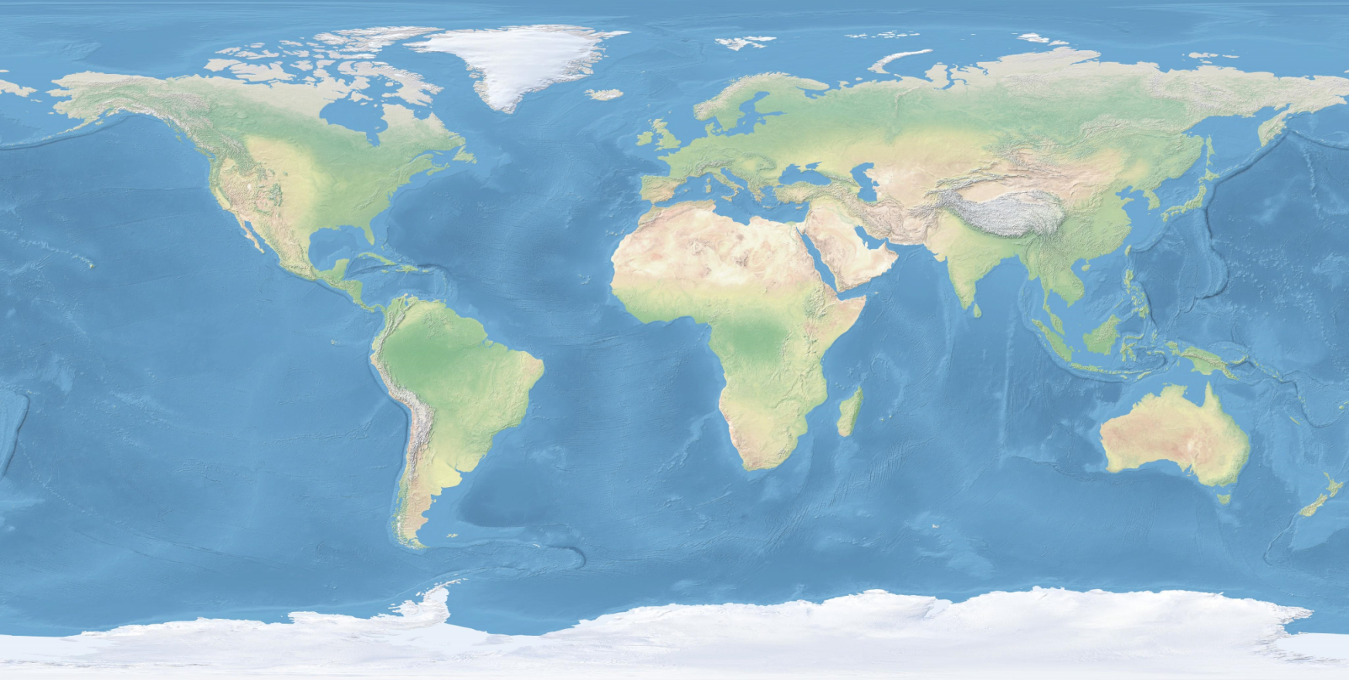
Mapping imagery to terrain
Notes:
In a perfect world, every terrain tile would have a single color texture, and life would be simple. But as I mentioned before, Cesium has to deal with the data that is available. So, for each terrain tile, we must compute which imagery tiles apply to it, as well as how to transform them during rendering. There are usually multiple imagery tiles associated with each terrain tile.
First, we determine which quadtree level of imagery applies to the tile. For imagery, we can think of the real-world spacing between texels as our geometric error. Then, we choose a level that maps each texel as closely as possible to a single pixel on the screen. For example, if we’re allowing up to two pixels of screen-space error when selecting geometry, we should select an imagery level with half of the geometric error of the terrain tile in order to guarantee each texel maps to a pixel or less on the screen. If a texel fills more than one pixel on the screen, the imagery tends to look blurry.
With the level selected, we then determine which imagery tiles contain the northwest and southeast corners of the terrain tile – the red dots shown here. Every tile in the rectangular range defined by those corner points is associated with the terrain tile and passed to the terrain fragment shader as sampler uniforms.

Slide 23
Fragment Shader
Notes:
Here’s a snippet of that fragment shader. This snippet is invoked multiple times, once for each associated imagery texture.
You can see we’re sampling the texture on the second line, but what’s all this other stuff?
Well, the first line transforms the terrain tile’s texture coordinates, which remember I mentioned earlier go from 0.0 to 1.0 linearly with longitude and latitude, to imagery tile texture coordinates by applying a scale and translation passed to the shader as uniforms. I’ll explain how these are computed shortly.
Then there’s this alpha multiplier stuff. It uses more two uniforms, extentMin and extentMax, to control the rectangular extent of the terrain tile that this imagery tile actually applies to. If we’re outside the extent, textureAlpha is 0.0 and this tile will not have any impact on the fragment.
Let me show you how those uniforms are computed.

Slide 24
Texture Scale
imageryHeight
scaleX = terrainWidth / imageryWidth
scaleY = terrainHeight / imageryHeight
imageryWidth
terrainHeight
terrainWidth
Notes:
Here’s our intersecting imagery tiles again, and let’s look at just one of them.
Here’s how we compute that scale uniform. It’s just the terrain tile width and height divided by the imagery tile width and height, expressed in radians of longitude and latitude.

Slide 25
Texture Translation
offsetX
translationX = scaleX * offsetX / terrainWidth
translationY = scaleY * offsetY / terrainHeight
offsetY
Notes:
And the translation is the offset of the imagery tile’s southwest corner from the terrain tile’s southwest corner, expressed as a scaled fraction of the terrain tile’s dimensions. The offset is directional, of course.

Slide 26
Texture Extent
offsetX
extentMinX = offsetX / terrainWidth
extentMinY = offsetY / terrainHeight
extentMaxX = (offsetX + imageryWidth) / terrainWidth
extentMaxY = (offsetY + imageryHeight) / terrainHeight
offsetY
Notes:
And finally, here’s how we compute the range of terrain tile texture coordinates for which this imagery tile applies. We have to be careful with this. For a terrain tile that is completely covered by imagery, the extent of the first imagery texture should start at 0, and the last one should end at 1. Failure to ensure this, due to rounding errors or otherwise, will cause cracks to appear between tiles. Similarly, the maximum texture coordinate of one imagery texture better equal the minimum coordinate of the next, or cracks will appear within the terrain tile.

Slide 27
Fragment Shader
Notes:
Here’s that fragment shader snippet one more time, where you can see how the scale, translation, extentMin, and extentMax are used.

Slide 28
Agenda
Overview of LOD algorithm – Chunked LOD
Mapping imagery to terrain
Map reprojection on the GPU
Horizon culling

Slide 29
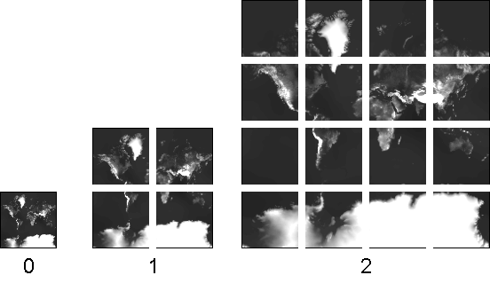
Map Reprojection
Geographic / Plate Carrée (EPSG:4326)
Web Mercator (EPSG:3857)
Notes:
Terrain tile texture coordinates in Cesium are constructed according to the map projection on the left here, such that geodetic longitude and latitude are linear functions of the texture coordinates. This is a pretty common projection, and lots of data is available in this projection. Cesium is a web application, though, and the vast majority of web maps, including Google Maps, Bing Maps, and most of Esri’s newer stuff use this projection on the right, known as Web Mercator Auxiliary Sphere. At first it may seem like an odd choice, because it uses an even more excessive number of pixels near the poles and it can’t represent latitudes above about 85 degrees at all.
The web map guys love this projection, though, because when you draw it in 2D, square buildings look square. Given the vast quantity of imagery available using this projection, we considered it very important that Cesium support it out-of-the-box. The different extents of tiles in the two projections are already handled by the texture scale and translation we just discussed. But within the extent, the mapping between geographic texture coordinates and Web Mercator texture coordinates is not linear. So we need to do something more.
Our approach is to reproject each Web Mercator imagery tile to geographic using the GPU on tile load.

Slide 30
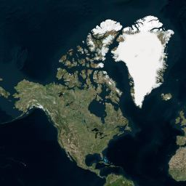
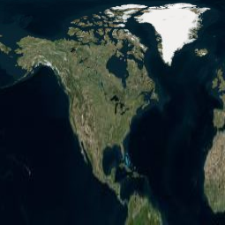
Web Mercator Reprojection
mercatorY = 0.5 * log((1.0 + sinLatitude) / (1.0 - sinLatitude))
mercatorOffset = mercatorY – southMercatorY
mercatorT = mercatorOffset * oneOverMercatorHeight
Notes:
The s texture coordinate is the same in the geographic and Web Mercator projections. In other words, the image varies with longitude in the same way in both projections.
The t texture coordinate is computed as shown here. We compute latitude from the geographic t coordinate, and then take its sine. Next we use this top formula to transform the latitude to a Mercator angle in the range –PI to PI. Then, we subtract the Mercator Y coordinate of the southern edge of tile, which we compute on the CPU and pass in as a uniform. And finally we scale to the range 0.0 – 1.0 by multiplying by the inverse of the difference in the Mercator Y coordinate between the northern and southern boundaries of the tile, again using a value passed as a uniform.
The end result looks like this. In the Northern hemisphere, Northern latitudes get compressed and southern latitudes get stretched.
We do this reprojection on the GPU by rendering to a framebuffer with a color attachment and transforming the geographic texture coordinates to Web Mercator with the equations above before sampling the Web Mercator texture. There are a couple of gotchas with this, however.

Slide 31
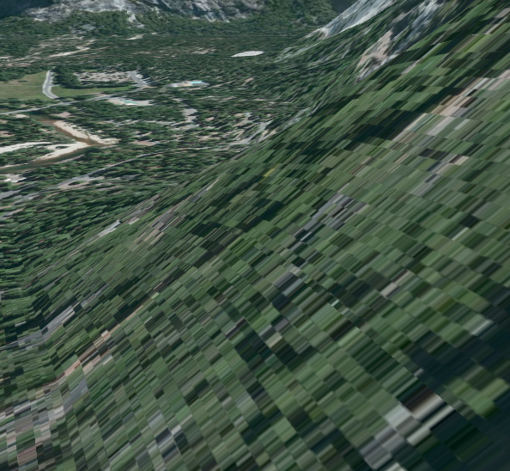
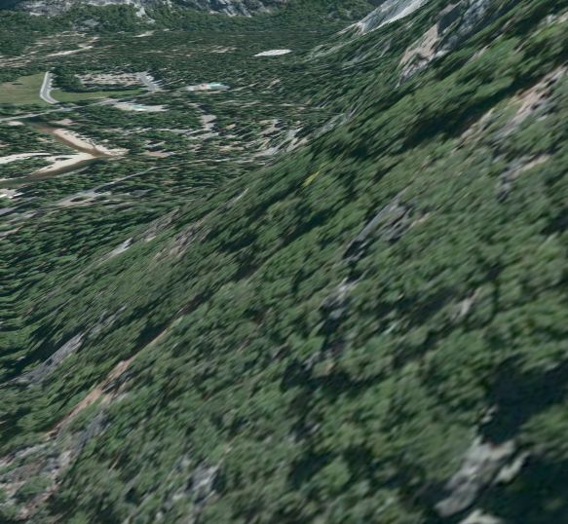
GPU Reprojection Gotchas
Problem: Limited floating-point precision
Solution: Texel spacing cutoff
Notes:
The first gotcha is a common one in massive worlds: the GPU lacks the floating-point precision to do this transformation in all cases. It manifests as blocky artifacts at close zoom levels, as seen in the screen shot on the left. In the screen shot on the right, the problem has been fixed.
Sometimes, we can overcome these sorts of precision problems by using simulated double-precision floating point arithmetic on the GPU. Unfortunately, our reprojection operation requires the transcendental functions log and sine. Simulating double-precision for these functions is, at best, extremely expensive. Instead, we use a much simpler trick. We simply stop doing the reprojection.

Slide 32
Texel Spacing Cutoff
Notes:
What do I mean? Ok, Let’s say we skip the reprojection and assume a Web Mercator image is the same as a Geographic image. We effectively introduce error in the texture coordinates. But how much error? This chart shows the maximum magnitude of that error at any latitude for the first 20 levels of the imagery tile quadtree. As you can see, the error drops sharply as we go deeper in the tree. At level 8, the error is smaller than a texel of a 256x256 image. At level 11, the error is smaller than 1/10 of a texel, which we consider acceptable. Empirically, these block artifacts do not appear until after level 11, so cutting off the reprojection at that level is an effective strategy and the one used by Cesium.
This works great as long as we have something close to 32-bit floating point numbers available. What if we don’t? That’s brings me to the next gotcha.

Slide 33
GPU Reprojection Gotchas
Problem: Many mobile GPUs have limited fragment shader precision.
Solution: Reproject in the vertex shader instead of the fragment shader.
Notes:
Unfortunately, many mobile GPUs don’t even have single-precision floating point arithmetic available to their fragment shaders. On these mobile devices, our strategy so far results in blocky smearing artifacts, like the ones we saw a couple of slides ago. The difference is, these artifacts show up much earlier than level 11, and in fact show up while the reprojection has a very noticeable impact on the imagery. We can’t just cut off the projection earlier on these devices. So what do we do?
Our solution is to compute the texture coordinates in the vertex shader instead of in the fragment shader. Conveniently, even mobile GPUs, at least the relatively recent ones, have reasonable precision in their vertex shaders. In order to do this accurately, we need to ensure that we have one vertex per output texel, or a grid of 256x256 vertices for a 256x256 output image. Using the obvious approach of computing the reprojected texture coordinates in the fragment shader, we only need 2x2 vertices. Fortunately, the vertex buffer is shared and unmodified for all reprojections. In addition, our fragment shader becomes trivial with this modified approach, so overall the performance is very similar to the original approach on desktop systems and has the rather nice benefit of producing correct results on mobile devices.

Slide 34
Agenda
Overview of LOD algorithm – Chunked LOD
Mapping imagery to terrain
Map reprojection on the GPU
Horizon culling

Slide 35
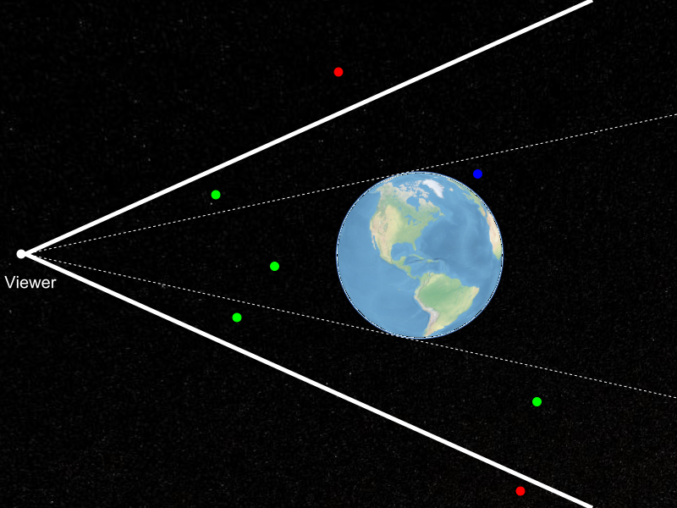
Horizon Culling
Notes:
Horizon culling is a form of occlusion culling that is very effective for any spherical or ellipsoidal massive world. Ellipsoids are important because WGS84, a very common, idealized model of the shape of the Earth, is an ellipsoid, In this picture, terrain tiles covering the entire Earth lie inside the view frustum, represented as heavy white lines. The red points are not visible because they are outside the view frustum. The green points are visible. And the blue point is inside the view frustum, but it is not visible to the viewer because it is occluded by the Earth. Horizon culling aims to separate the green points from the blue ones. We have formulated a novel and very efficient test for determining if a tile is below the horizon of an ellipsoid.
By doing horizon culling as well, instead of just view-frustum culling, we reduce the number of tiles rendered by as much as 50% for common views.

Slide 36
Ellipsoid-scaled space
Ellipsoid
WGS84 | Length (meters)
a | 6,378,137.0
b | 6,378,137.0
c | 6,356,752.314245
x, y, z is any position on the surface of the ellipsoid
a, b, c are ellipsoid semi-axis lengths
Ellipsoid-scaled space:
Is centered on the ellipsoid
Axes are aligned with ellipsoid axes
Ellipsoid is a unit sphere.
Scale to ellipsoid-scaled space:
[Cozzi10]
Notes:
Our horizon culling technique requires us to work in the ellipsoid-scaled space. This is a coordinate system that is centered on the ellipsoid, that has axes aligned with the ellipsoid’s axes, and in which the ellipsoid itself is represented by the unit sphere. That may sound like a lot of requirements, but for a virtual globe application like Cesium, the coordinate system used for rendering probably already meets the first two requirements. The last one is achieved by multiplying coordinates by the scaling matrix shown here.

Slide 37
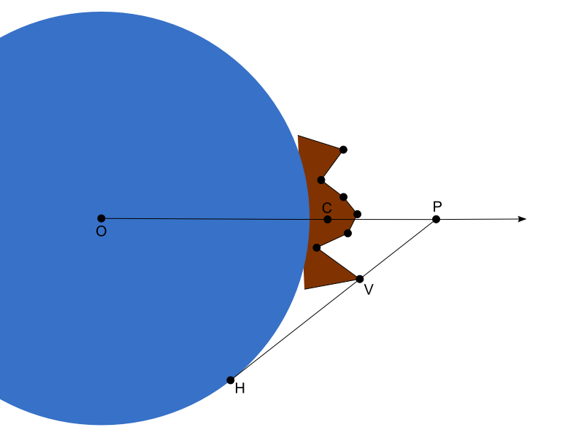
Horizon occlusion point
[Ring13b]
Notes:
In this diagram, the Earth is the blue sphere and a terrain tile is shown in brown. Let’s compute what we call the horizon occlusion point for this tile. The horizon occlusion point is a point with a useful property: when the point is below the horizon, the entire tile is below the horizon as well.
Vector OC is a vector from the center of the Earth to the approximate center of the tile. We’re going to make the executive decision that our horizon occlusion point, P, will lie along this vector. So really, we just need to compute the magnitude of point P.
You can see from the diagram that point P is the intersection of vector OC with vector HV. Point V is a vertex in the terrain tile. Point H is a point on the horizon from the perspective of point V. There are actually an infinite number of horizon points, but only two of them form vectors that intersect with vector OC. One of those two vectors is shown in this diagram. The other would intersect with vector OC before passing through point V, so the intersection will be closer to the ellipsoid, so we’re not interested in that one.

Slide 38
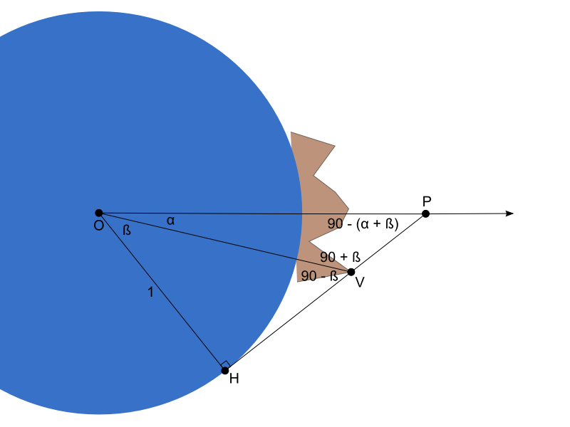
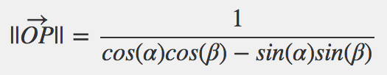
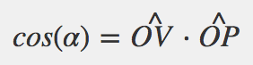
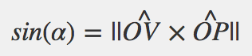
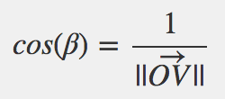
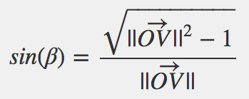
Horizon occlusion point
[Ring13b]
Notes:
If we label the angles in this diagram, we start to see how we can solve for the magnitude of vector OP. I walk through the full derivation in the blog post referenced here, but I’ll skip that here in the interest of time. It all boils down to this top equation, where the sine and cosine terms are computed as shown.
We repeat this computation for every vertex in the terrain tile mesh, and then choose the magnitude of OP is that greatest, and that becomes our horizon occlusion point for the tile. Ideally we would do this computation in a terrain pre-processing step, but it’s cheap enough that we can reasonably do it on tile load as well.
Remember, the occlusion point is represented in the ellipsoid-scaled space. This is actually convenient for testing the point for occlusion by the ellipsoid.

Slide 39
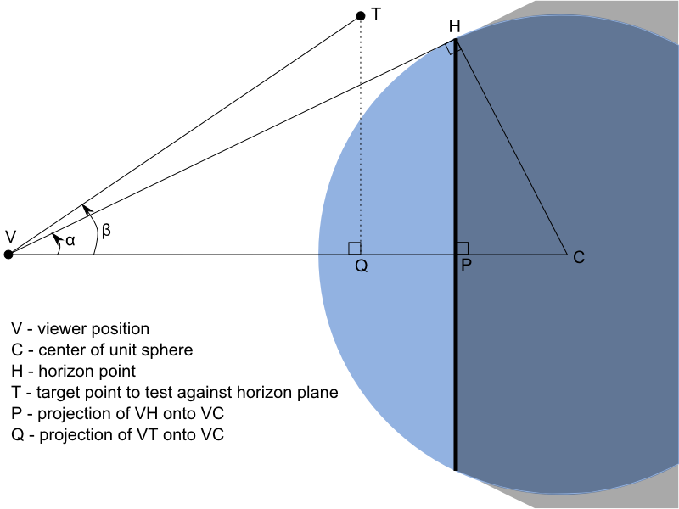
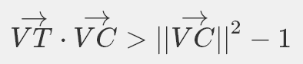
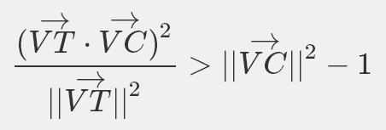
Testing the occlusion point
Plane Test:
Cone Test:
[Ring13a]
Notes:
Now, we’ve constructed this point such that if it is occluded, then the entire tile is occluded as well and we can skip rendering it. So how do we test the point for occlusion?
Again the full derivation is in the cited blog post, but it boils down to two inequalities. The first tests if the point is behind the plane shown with a dark line in this diagram. If the point is in front of this plane, then it is not occluded by the ellipsoid and we’re done. If it is behind the plane, we apply the second test.
The second test determines if the point is inside the cone formed by connecting lines from the viewer to the infinite number of ellipsoid points that form the viewer’s horizon. If the point is inside that cone, it is occluded by the ellipsoid. Otherwise, it is not.
These tests do not require any transcendental functions, so they’re very fast. And it also significantly reduces the number of tiles we need to render.

Slide 40
Acknowledgements
Frank Stoner
Scott Hunter
Notes:
I’d like to thank Frank Stoner for working out this horizon culling technique and for patiently explaining it to me.
I’d also like to thank Scott Hunter for his work on the implementation of the terrain and imagery engine presented here, as well as his help in writing up the details of how it works.

Slide 41
Final Thoughts
Open source implementation of everything I presented:
http://cesium.agi.com
Find more information in the course notes:
http://cesium.agi.com/massiveworlds
Thanks for listening!

Slide 42
References
[Cozzi10] Patrick Cozzi and Frank Stoner. 2010. GPU ray casting of virtual globes. In ACM SIGGRAPH 2010 Posters (SIGGRAPH '10). ACM, New York, NY, USA, , Article 128 , 1 pages.
[Klein96] Reinhard Klein, Gunther Liebich, and Wolfgang Straßer. 1996. Mesh reduction with error control. In Proceedings of the 7th conference on Visualization '96 (VIS '96), Roni Yagel and Gregory M. Nielson (Eds.). IEEE Computer Society Press, Los Alamitos, CA, USA, 311-318.
[Ring13a] Kevin Ring, Frank Stoner. Horizon culling. 2013.
[Ring13b] Kevin Ring, Frank Stoner. Computing the horizon occlusion point. 2013.
[Ulrich02] Thatcher, Ulrich. Rendering Massive Terrains Using Chunked Level of Detail Control. In SIGGRAPH 2002 Super-Size It! Scaling Up to Massive Worlds Course Notes. New York: ACM Press, 2002.

